Slide 1
The Evolving Evolutionary Spectrum
Mark Fiecas
Hernando Ombao

Slide 2
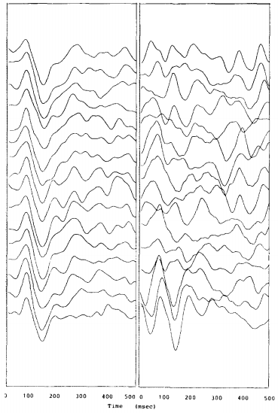
Evidence of Nonidentical Trials
Gasser et al, 1983

Slide 3
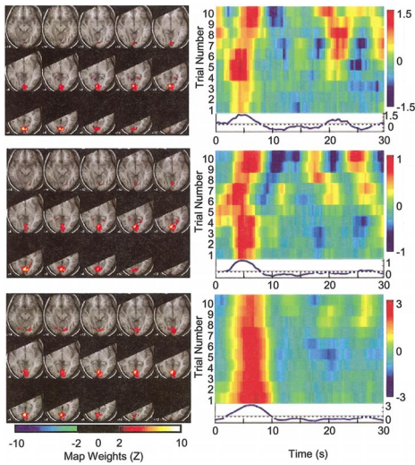
Evidence of Nonidentical Trials
Duann et al, 2001

Slide 4
Evidence of Nonidentical Trials
EEG
Gasser et al, 1983; Turetsky et al, 1988
MEG
de Munck et al, 2004
fMRI
Duann et al, 2004; Pfleiderer et al, 2002
Neuronal Spike Trains
Czanner et al, 2008; Smith et al, 2004
LFPs
Truccolo et al, 2002; Menzer et al, 2009

Slide 5
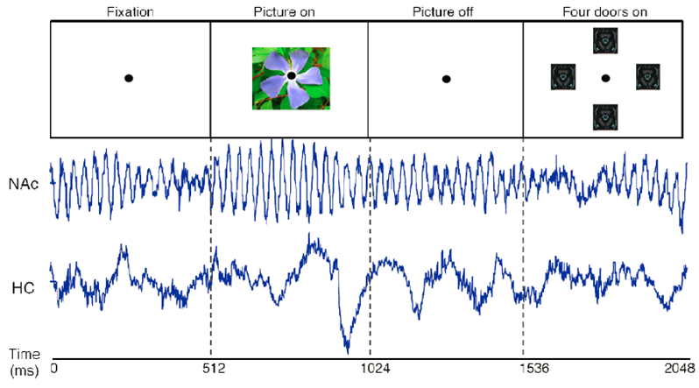
An Associative Learning Experiment
Adapted from Gorrostieta et al, 2012

Slide 6
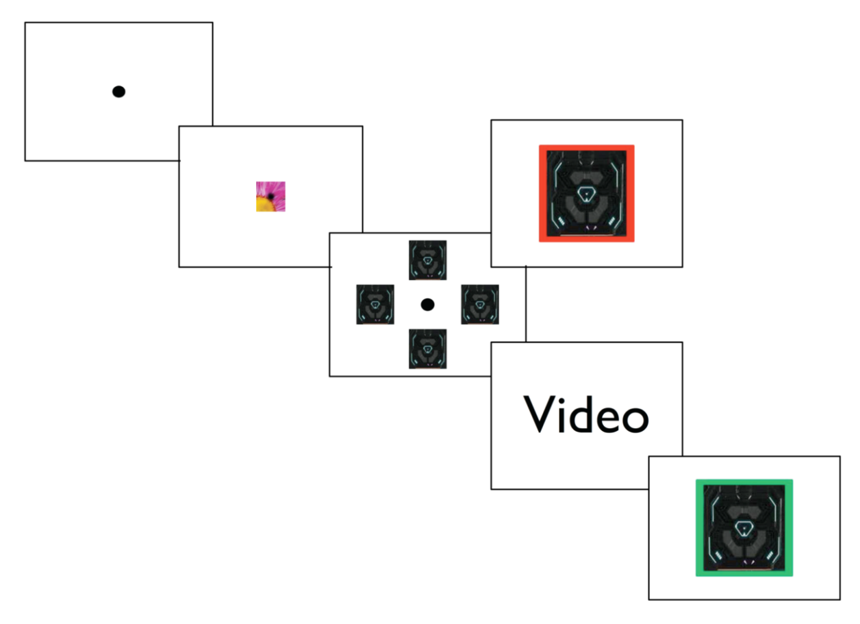
An Associative Learning Experiment
Time

Slide 7
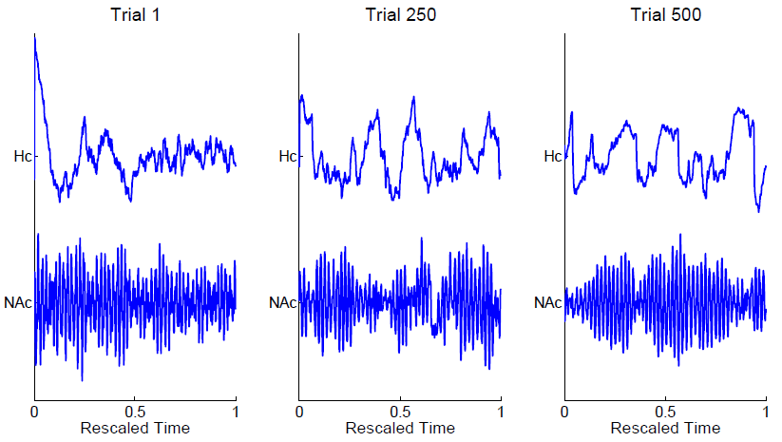
The Data

Slide 8
Data Characteristics
Small signal-to-noise ratios

Slide 9
Data Characteristics
Nonstationary time series data

Slide 10
Data Characteristics
Evolving over time within a trial
Nonidentical trials across the experiment

Slide 11
The Time Series Models
Weakly stationary time series (Brillinger, 1981):

Slide 12
The Time Series Models
Locally stationary time series (Guo et al, 2003):

Slide 13
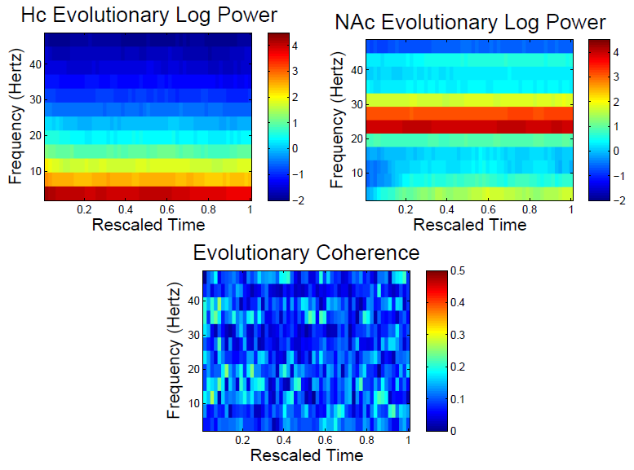
Time-Frequency Plots

Slide 14
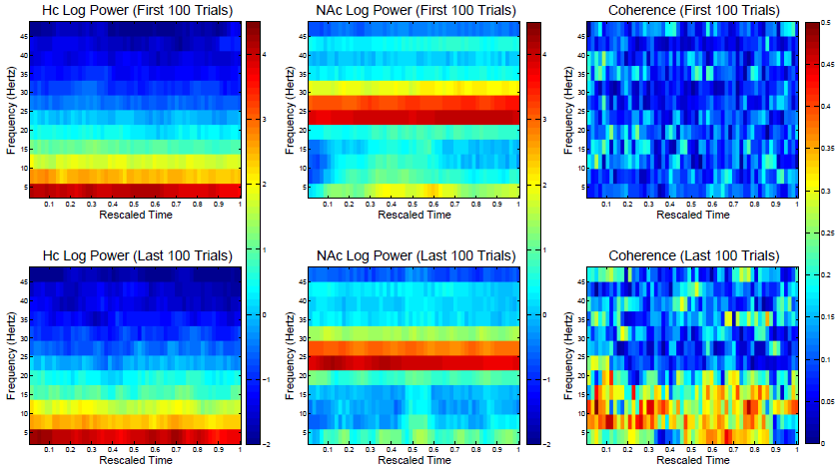
Evidence of Nonidentical Trials

Slide 15
The Evolving Evolutionary Spectrum

Slide 16
Time-Replicate-time Plots

Slide 17
Time-Replicate-time Plots

Slide 18
Time-Replicate-time Plots

Slide 19
The Model
A slowly evolving locally stationary process:

Slide 20
Discussion
How does the evolution relate to behaviour?

Slide 21
Discussion
Averaging over the trials may yield an incorrect characterization of the data.

Slide 22
Discussion
The trials may be correlated.

Slide 23
Acknowledgements
Hernando Ombao, UCI Statistics
Emad Eskandar and Shaun Patel, MGH
Rainer von Sachs, UCL Statistics

Slide 24
“Understanding how the brain works is arguably one of the greatest scientific challenges of our time.”
- Alivisatos et al, 2013

